Slide 1

Project Title – Keystroke Logging Demonstration
[Student Name ]-
TEJASWI KUMAR
[AICTE ID : ]
STU68f8ad25150c91761127717

Slide 2

PROBLEM STATEMENT
Keystroke logging is a technique that can be misused to steal sensitive user information like passwords and personal data.
Most users are unaware of how such attacks work and how they can protect themselves.
This project aims to create awareness about keystroke logging and its security risks.

Slide 3
Project Description
[write detail description about your project ]
This project demonstrates the basic working concept of keystroke logging in a safe and ethical environment.
The project does not capture or store any sensitive information.
It only shows how typing events and timing can be analyzed for educational and cybersecurity awareness purposes.

Slide 4

WHO ARE THE END USERS?
Students learning cybersecurity
Beginners in ethical hacking
IT & Computer Science students
General computer users
Cyber awareness trainees

Slide 5

Technology Used
  Python Programming Language
  Time module
  Keyboard input concepts
  Text-based input handling
  Cybersecurity principles

Slide 6
RESULTS
[Add screen shots of your code ]
Understanding of keystroke logging concept
Awareness about privacy risks
Knowledge of ethical vs malicious usage
Improved cybersecurity awareness
Demo Link

Slide 7
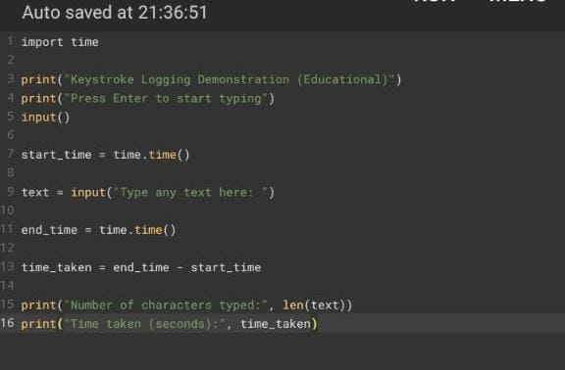
RESULTS
[Add screen shots of your code ]
Demo Link

Slide 8
Certificate - Protection from browser attacks
This certificate helped in understanding browser-based threats and protection mechanisms related to cybersecurity.

Slide 9
Certificate - Introduction to System Security
Learned basic system security concepts, threats, and preventive measures.

Slide 10
Certificate - Securing Android Devices
Gained knowledge about mobile security risks and protection techniques.

